Slide 1

Evidence: Evolution of technology in software development Student: Rodney Zapata. course: 26 75 810

Slide 2

Evolution of technology in software development :
The evolution of technology in software development has been a dynamic and continuous process, marked by significant advancements and paradigm shifts. Here's a brief overview of key stages in the evolution of technology in software development

Slide 3

Manual Coding (1940s-1950s):
Early computers required programmers to manually input machine code instructions using punch cards or other primitive methods.
Assembly languages were developed to make programming somewhat more human-readable.

Slide 4

Integrated Development Environments (IDEs) (1970s-1980s):
IDEs like Turbo Pascal and Microsoft Visual Studio emerged, providing a comprehensive environment for software development.
These environments introduced features such as code editing, debugging, and project management tools.

Slide 5
Graphical User Interfaces (GUIs) (1980s-1990s):
The advent of graphical interfaces, driven by the development of desktop operating systems like Windows and MacOS, influenced software design and user experience.
GUIs made software more accessible to non-technical users.

Slide 6
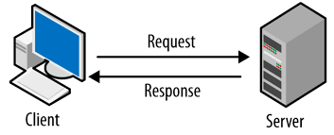
Client-Server Architecture (1980s-1990s):
Networking technologies improved, leading to the development of client-server architectures.
This model distributed processing tasks between client and server, enabling more scalable and efficient applications.

